Slide 1
Scrum Unleashed
The 5 Values
(and 3 lessons)
Notes:
I’d like to share 3 lessons I’ve learned about why it’s difficult at times to practices these values:
Fear of Failure may have become a conditioned response.
Our Inner Critic is the Enemy of agility
Practicing the Scrum Values may require an internal shift.

Slide 2


Jason Knight
Scrum Master
Lean Coach
Internal Consultant
Notes:
Scrum Master
Lean Coach
Internal Consultant

Slide 3





Jason Knight
Notes:
Over the years, I’ve earned lots of badges. These are some of my favorites.

Slide 4


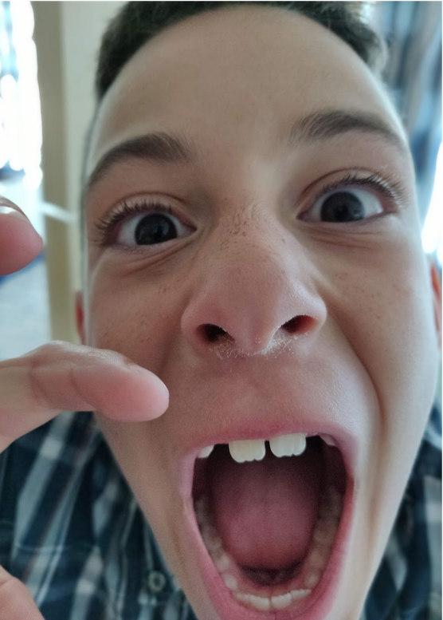
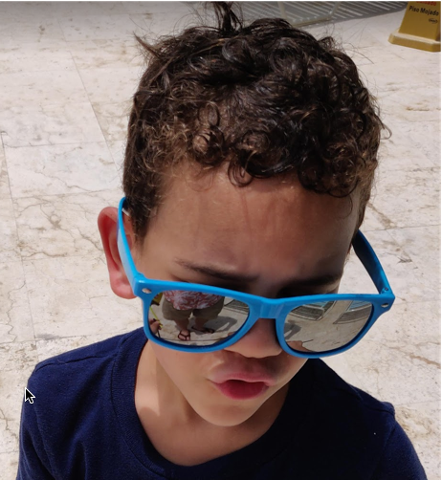
Jason Knight
Notes:
This is perhaps my favorite qualification for learning how to navigate complexity and change. My wife Mardel and our kids Elena, Emory and Franklin keep us hopping every day.

Slide 5
Scrum Values
Courage
Respect
Openness
Commitment
Focus
Notes:
Schwaber and Jeff Sutherland added 5 Scrum values
Had been around… User Voice
These values had been written about long before and due to a User Voice voting, they made it into a revision last year I believe. I was very pleased to see this. Teams practicing Scrum but without acting in alignment with these values are only mimicking Scrum and missing its power. Thus the values should be included in the guide.
First, let’s refresh out memories. Successful use of Scrum depends on people becoming more proficient in living these five values.
The Scrum Team members have courage to do the right thing and work on tough problems.
Scrum Team members respect each other to be capable, independent people.
The Scrum Team and its stakeholders agree to be open about all the work and the challenges with performing the work.
People personally commit to achieving the goals of the Scrum Team.
Everyone focuses on the work of the Sprint and the goals of the Scrum Team.

Slide 6
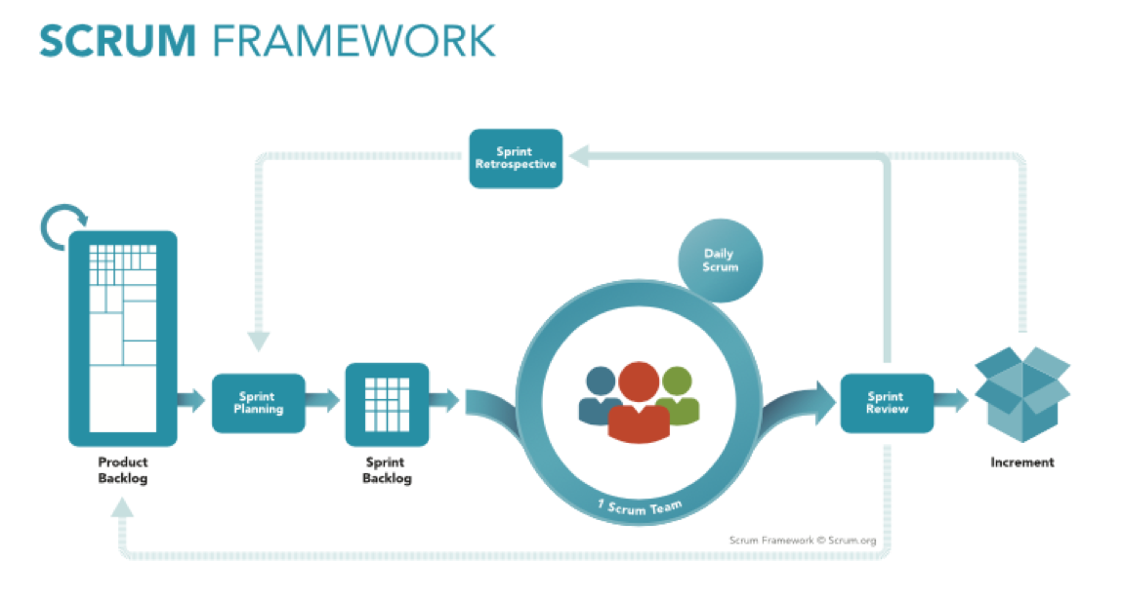
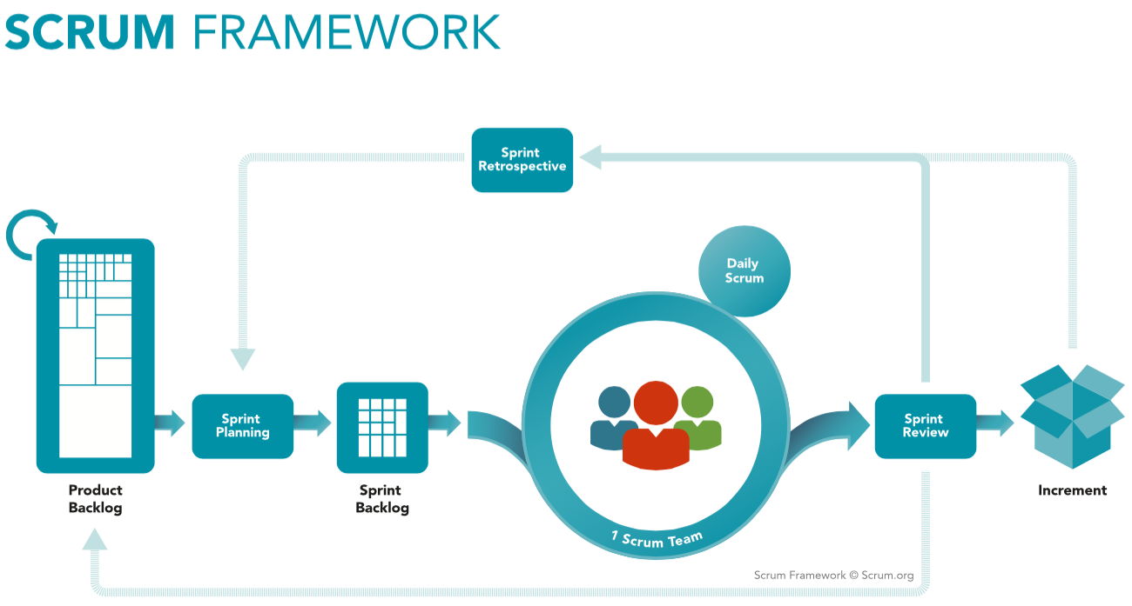
Notes:
There are innumerable ways that acting according to these values is of great benefit in Scrum, but I’d like to draw your attention to these, four events. Each one of them is an opportunity for the Scrum team to inspect and adapt something. In essence, each event is planned moment to catch failures and fix problems.
Hooray! Install Scrum ...Be Agile!

Slide 7
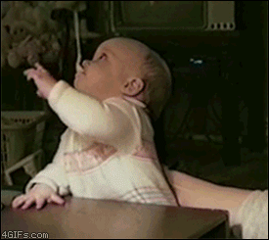
Notes:
Until you realize that even though Scrum is lightweight and simple to understand, it is also very very difficult to master.
You might say, you've a little taste of what's possible, but you just can't get your hands around it.
But what makes it so difficult? I have a theory, but first let’s talk about failure.

Slide 8
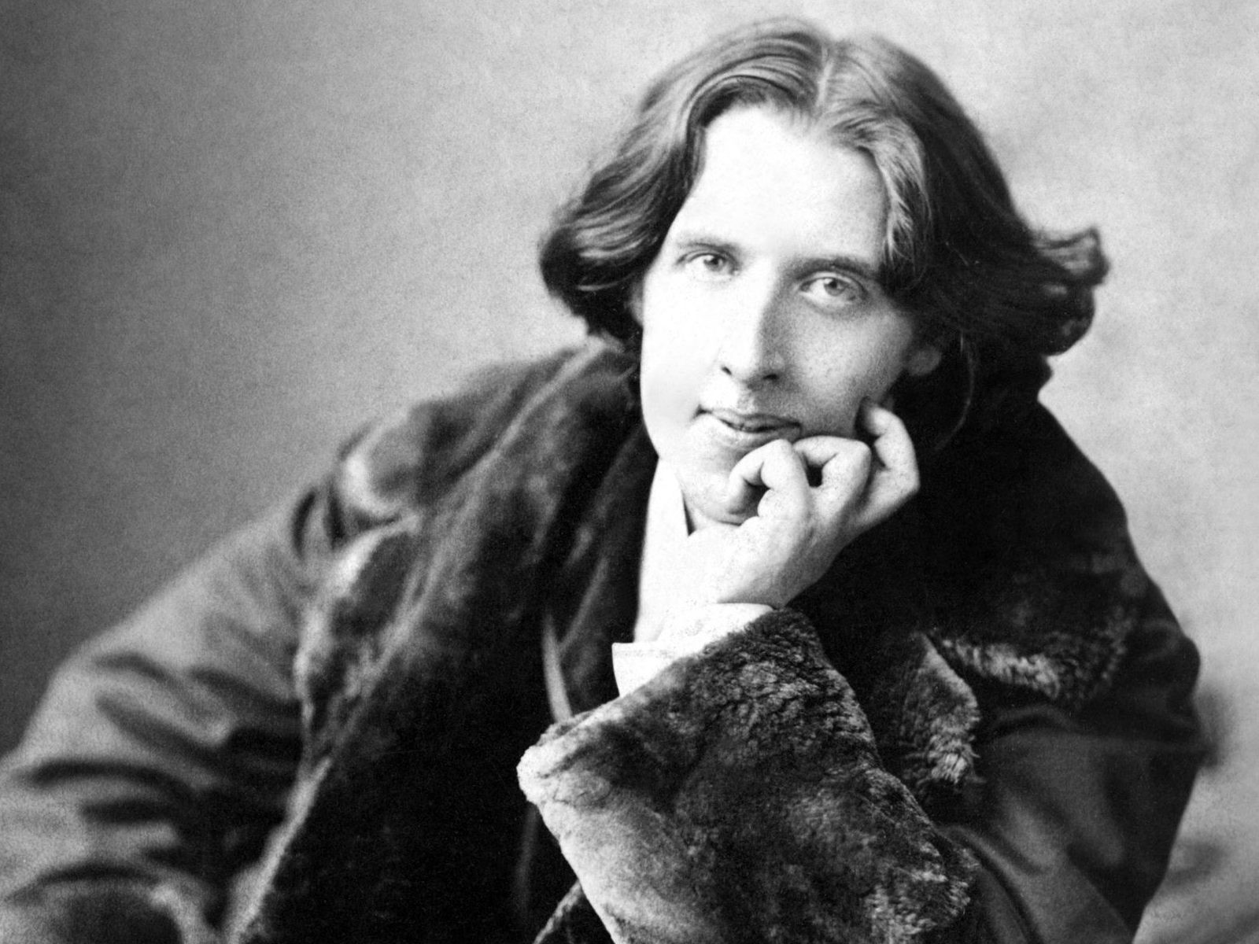
“Experience is the hardest kind of teacher. It gives you the test first and the lesson afterward.” — Oscar Wilde
Notes:
I’m sure all of you can relate to this quote.

Slide 9
Notes:
We’ve all had those moments where we learn painful lessons from failure.

Slide 10
Notes:
Sometimes the pain is self-inflicted…

Slide 11
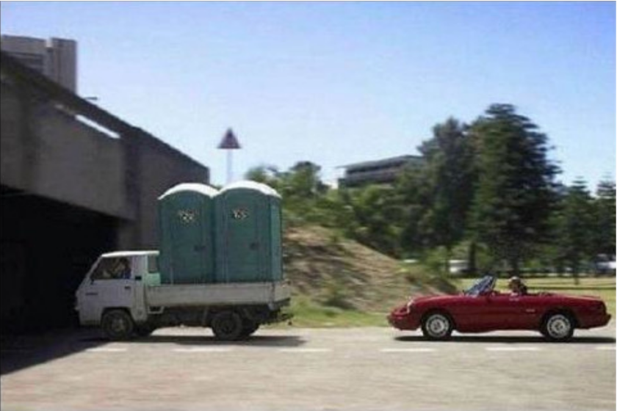
Notes:
Sometimes, it’s just the wrong day to leave the top down on your convertible.

Slide 12
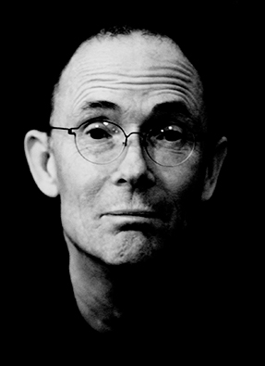
“The future is already here — it's just not very evenly distributed.” — William Gibson
Notes:
Thankfully, we’re in the 2010’s.
Failure is more often greet as a learning opportunity.
The future is here. It’s just not evenly distributed.
Let's try this. I'll make a statement. Don’t worry about whether it’s true in every case, just listen to and stay curious about your reaction.
Without failure, there is no learning.
Do you welcome this way of thinking? Does it offend your sense of pride? Does it strike fear into your heart?

Slide 13
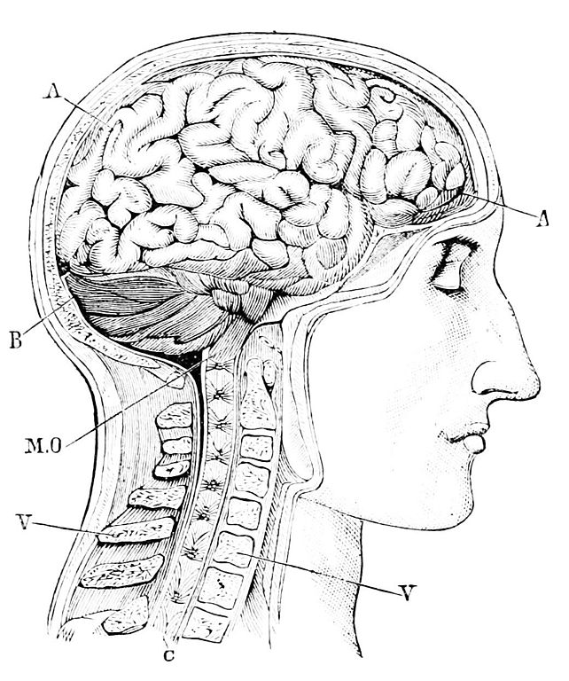
Lesson #1: Conditioned to Fear Failure
Always:
appear competent
know the answer
have a plan that works
Never:
appear weak
drop the ball
let your guard down
Notes:
Our own physiology and psychology conditions us to fear and avoid failure.
Our brains store bad things in implicit memory. Basically, our intuition begins to guide us automatically away from failures.
This make a lot of sense actually. If you stepped on a rattlesnake along a forest trail, you’d remember the snake instead of how lovely the trail turned out to be. Failure with that snake could mean death after all!
As a result, we may begin to intuitively agree with phrases like these
Always appear competent
Always know the answer
Always have a plan that works
Never appear weak
Never drop the ball
Never let your guard down

Slide 14
Avoid Failures at All Costs
Notes:
Over time, we may develop the sense that failure is our enemy. It’s Just. Too. Painful.
Many times this intuitive posture towards failure forms in us when we’re very young. Remember grade school and junior high? Remember that moment someone told you your art project sucked, you were a weakling for being afraid of or uninterested in sports or that you just didn’t have it all together and that meant you were somehow lazy or a slacker.
These types of experiences can leave deep scars that orient us for a lifetime.

Slide 15

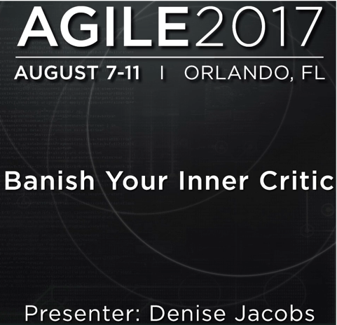
Denise Jacobs
https://vimeo.com/229468993
Notes:
Denise Jacobs has written a great book called, “Banish Your Inner Critic.” In my opinion, the concepts we lays out are crucial to understand if we are to practice the Scrum Values successfully. I’ve included a link here to her keynote at Agile 2017 where I first learned about this stuff.
She describes that voice in your head that seems to constantly criticize you and your actions. You know this voice well. It sounds like this.

Slide 16

Lesson #2: Our Inner Critic is the Enemy of Agility
If you ________________, then people will ________________.
You’re not ________________ enough.
You can’t ________________ because you’re not as ________________ as others.
You shouldn’t ________________ because you haven’t ________________.
You ________________ because your ideas ________________.
Notes:
If you’re like me, I never really thought about my thoughts too much. Think to yourself, how does the voice in my head want to fill in these gaps? Take a few seconds and just ponder what comes up for you as you read each of these.
These types of thoughts from the inner critic kill your practice of the 5 values. Forget being open if that voice is telling you, “If you open up then people will use it against you.” Kiss courage goodbye if that gremlin says, “You’re not smart enough, talented enough, thin enough, strong enough, fast enough, dedicated enough, male enough, female enough…ENOUGH!!!

Slide 17
Lesson #2 Our Inner Critic is the Enemy of Agility
What are our inner critics saying?
Notes:
It’s time to out the inner critic.
Everyone struggles with this. You are not alone.
Take pen and paper.
Use Non-dominant hand.
Write down what your critic is saying. Do NOT put your name on it.
Ball up the paper and chuck it across the room. We’ll do this several times for about 10 seconds.
By the end of this, no one will know who has written what, and using your non-dominant hand means no one will be able to recognize your handwriting.

Slide 18
“Scrum is lightweight, simple to understand…”
– The Scrum Guide

Slide 19
“I know what I need to do, but if I fail, others will blame me.”
# 1 Courage
Notes:
You hear yourself or someone else say, “I know what I need to do, but if I fail others will blame me.” Do you remember which one was doing the right thing and working on tough problems?
Courage is curtailed

Slide 20
“My teammates can’t be trusted to do
their part. Looks like I’ll have to do it myself.”
#2 Respect
Notes:
Respect is missing

Slide 21
“I know we can’t hit this deadline, but
we can’t tell our client we’re having problems.”
#3 Openness
Notes:
Openness is dead on arrival

Slide 22
“Looks like ‘my’ work is done. Time to
check Twitter…again.”
#4 Commitment
Notes:
Commitment is discarded.

Slide 23
“These top 50 backlog items are ALL priority. They all need to get done!”
#5 Focus
Notes:
Focus is forgotten then lost.

Slide 24
“Scrum is lightweight, simple to understand…and difficult to master.”
– The Scrum Guide
Notes:
DON’T FORGET THE EXERCISE!!!!!
See why it’s difficult?
Our nurture can have trained us to shy away from practicing the values
Even worse when
org chart
HR policies
“the way we do things around here”
Embody these attitudes.
I’ll ask each group to describe the challenges you or your teams have had practicing your group’s value.
For into groups of 2 or 3. We need at least 5 groups, but more is fine. I’ll ask each group to pick a value to discuss. At the end of the exercise, I’ll ask each group to describe the challenges you or your teams have had practicing your group’s value.
I’ll ask you and your group to choose a value to discuss. Each value should be chosen at least once before a value may be chosen a second time. I’ll leave it to you to speak up and choose your team’s value, so jump in quickly if you have a strong preference.
(kerfuffle)
Each person in your group will have 2 minutes to speak. We’ll regroup and I’ll ask each group to share out something about what you discussed.

Slide 25
“Scrum or Agile just won’t work here.”
Notes:
You and your teams may feel overwhelmed

Slide 27
Whoa, not so fast.

Slide 28
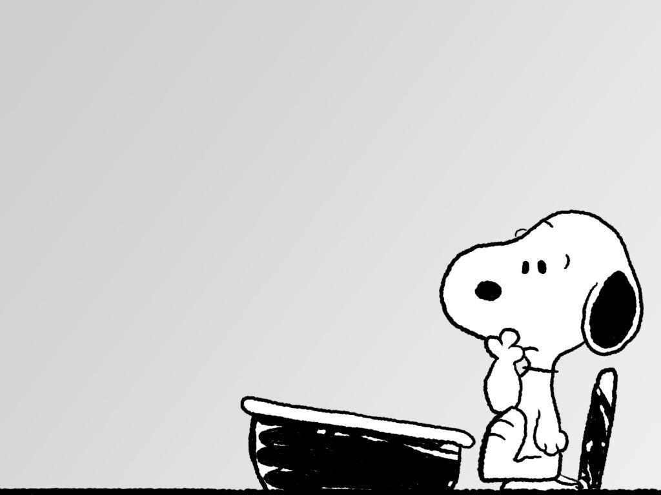
Lesson #3: Practicing the Scrum Values may require an internal shift.
How Can I Be?
Notes:
Weighty question.
Represents shift from doing to being.
Much more personal.
Much more risky
Requires vulnerability.

Slide 29

Decide
That’s it.

Slide 31
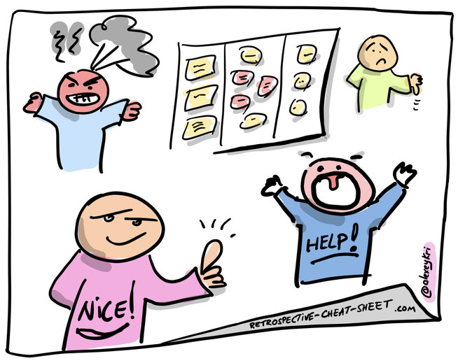
Create The Space You and Your Teams Need. Start with the Retrospectives.

Slide 32
Safe Open Focused on being

Slide 33
Do what you can Ask for help Publish upwards

Slide 34
“Resistance is simply a valid concern, poorly delivered.” - Anonymous

Slide 35

Find your voice
Help others find theirs

Slide 36
Scrum Values
Courage
Respect
Openness
Commitment
Focus

Slide 37
Unleash the Power of Scrum People!

